Slide 2
3D blade model updating by coupling HAWC2 and ABAQUS
Maria Luz Castilla Mena (s212601@dtu.dk)
Notes:
Hi, I am Maria and I am going to present my master thesis topic: Evolution of blade cracks with wind turbine simulation tolos (this is a provisional titile, it needs to be discussed)

Slide 3
INDEX
Introduction to the problem
From last meeting
Progress of the project
For the next meeting
Notes:
First of all, I am going to introduce the topic and the context of my Project, then I will outline the purpose of this meeting and I will discuss the results obtained during these past weeks. Afterwards, I will state what I would like the outcome of the meeting to be, and finally I will suggest a couple of things I could continue working until the next meeting.

Slide 4

XIMI: 20 mins presentation
Progress on Project
What have I done so far
Talk about understandings, comments, questions
Include task and list of subtasks, explain which ones went Good and which ones failed
XIAO:
Progress so far
Challenges and possible solutions
Plan for the next step
Work on:
More detailed summary and introduction of my work (background, objectives, significance, activities, expected results…)
Outline structure thesis/report
Timetable of my work
Tips:
Take note of what I think it should be useful for my work during the meeting
Give suggestions and constructive advice to other students

Slide 5

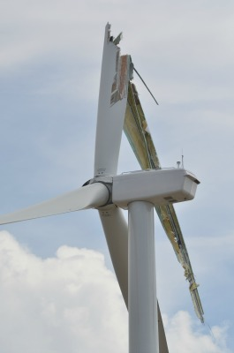
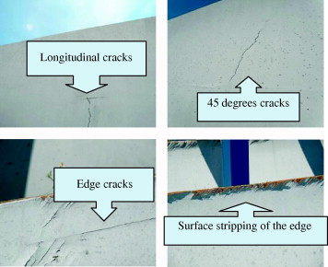
Introduction to the topic
Weak section
Vo
Notes:
Wind turbines are exposed to external conditions that can deteriorate its performance. In the aeroelastic context of a wind turbine, both the aerodynamic forces and the structural flexibility influence each other. The aerodynamic forces can make the blades suffer deformations and fractures may occur, and these deformations change the aerodynamic forces.

Slide 6
Problem approach
HAWC2
Abaqus
MATLAB
Notes:
3 softwares will be used to study the evolution of cracks that may appear in the blades due to the change in aerodynamic forces. Using the HAWC2 software, an aeroelastic wind turbine simulation tool, the aerodynamic forces are calculated and will be used in the ABAQUS software to calculate the deformation of the material and the new stiffness components, which will be needed again in the HAWC2 software to update the aerodynamic forces. Both softwares communicate with each other through MATLAB. A time simulation will be carried out using simultaneously the 3 softwares to study the evolution of cracks in the blades under certain external conditions.

Slide 7
From last meeting

Slide 8
From last meeting
Regarding HAWC2: just focus on the blades
10sec simulation to get the moments the blade withstands
For now, just focus on flapwise moment
Regarding MATLAB: create a file with HAWC2’s outputs that Abaqus can read
Create .inp file with HAWC2 outputs
Regarding ABAQUS:
Check the .inp file data structure
See if ABAQUS recognises my .inp file
Notes:
Check how the .inp file looks like for Dynamic analysis

Slide 9
Progress of the project

Slide 10


Progress of the project
Main objective: Get Abaqus to read an .inp file with the aerodynamic data from HAWC2
Subtasks:
Modify HAWC2 output file (.sel) to only get blade outputs (moments in time)
Create an .inp file with the data from HAWC2 in MATLAB
Create a simple beam model to simulate the blade structures
Import the created .inp file in Abaqus and see if it recognises the input

Slide 11
Results

Slide 12
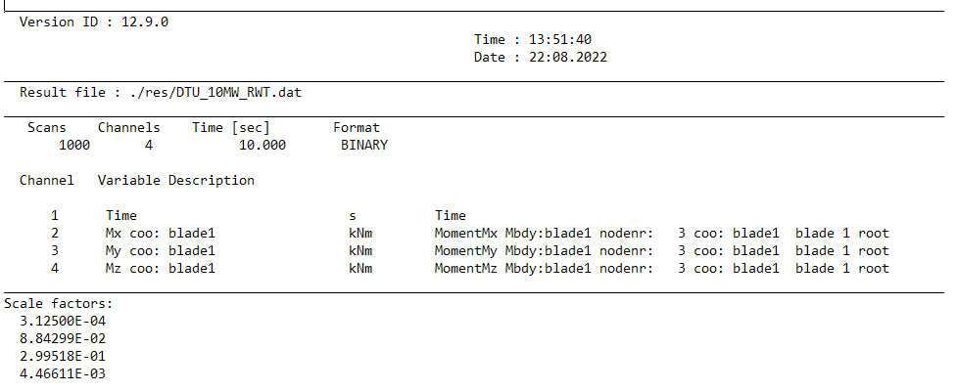
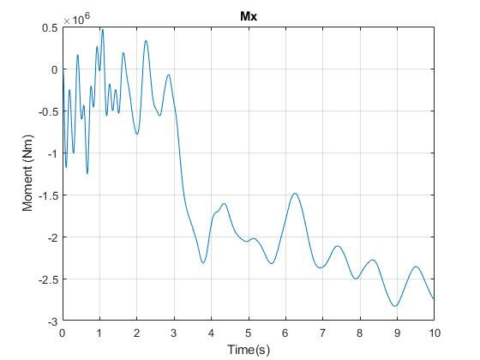
HAWC2 Output File: .sel

Slide 13
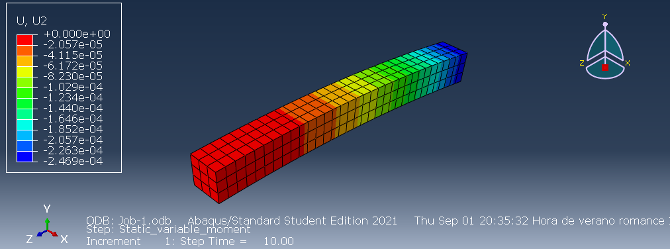
ABAQUS: Simple beam model with applied moment

Slide 14
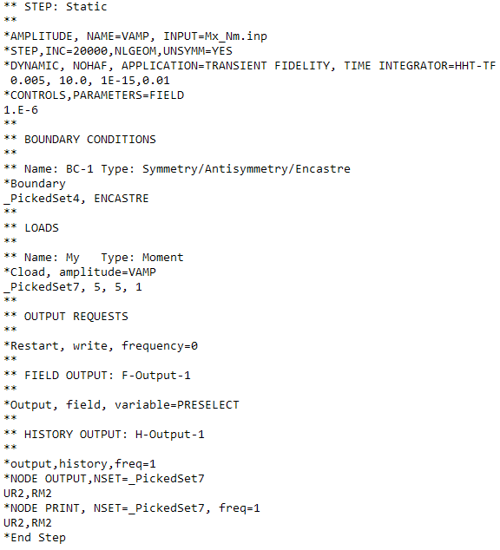
ABAQUS Input File: .inp
Important part: STEP
Amplitude: import from .inp file created
in MATLAB
Dynamic analysis – need to do a frequency analysis first?
Apply to the moment the imported amplitude
Weird results in the displacement of the free end

Slide 15
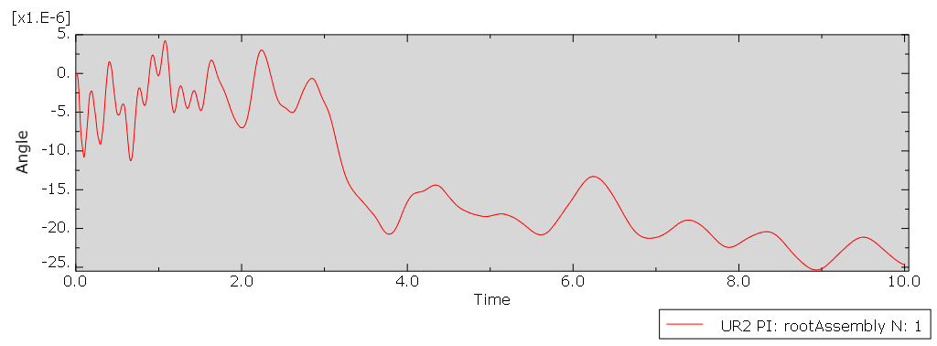
ABAQUS: Results

Slide 16
For next meeting…

Slide 17
For the next meeting
Install Abaqus full version
Get ABAQUS to recognise the moment as a variable moment
Develop MATLAB code that automatically creates .inp file with HAWC2’s outputs
Recall how to get the stiffness matrix for isotropic material
Start writing about the project’s background, objectives, expected results
Make a plan

